Slide 1
Streaming Data Pipeline
Bootcamp Student Edition
By Shaheer Khan

Slide 2
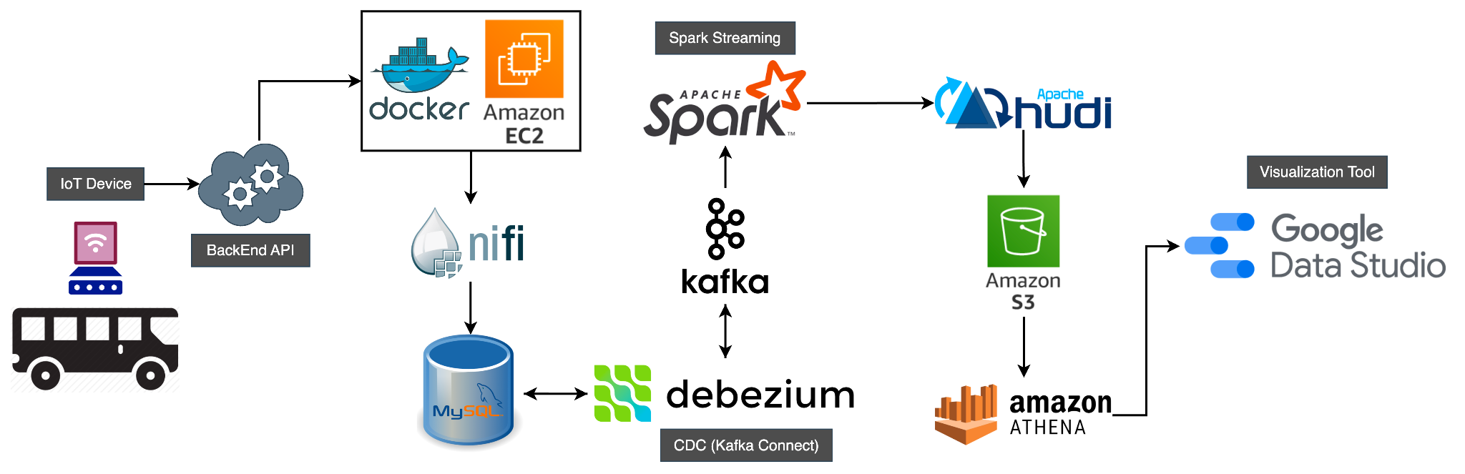
Architecture

Slide 3
Table of Contents
6
Tool: Kafka
1
Architecture 1
7
Tool: Spark Streaming
2
Problem Statement
8
Tool: Hudi/S3 Bucket
3
Tool: EC2/Docker
9
Tool: Athena
4
Tool: Apache Nifi
10
Tool: Google Data Studio
Tool: MySQL/CDC (Debezium)
5
11
Future Iteration
Notes:
Spark Streaming, Docker, MySQL

Slide 4
Problem Statement
Tasks
Part B: Data Extraction and Processing
Use Rest Bus api to get the data for the routes (509 & 511)
Use Apache Nifi for data extraction using Rest Bus API
Set up a MySQL database with an extra layer called Debezium for CDC
Ingest data (incoming messages) using Debezium as it records the history of data changes in Kafka topic
Transform the data using spark streaming
The project encompasses main aspects of a streaming data pipeline using a real-time application that collects GPS data steamed by IoT devices located on buses. The data source used in the project is TTC bus data from open API called Rest Bus
Part A: Setting up
Set up docker using EC2 instance on AWS for Apache NiFi, CDC (Debezium), Kafka, Spark Structured Streaming, MySQL
Part C: Storage, Analysis & Visualization
Store the transformed data in a hudi table on S3
Use Athena to query data from hudi table
Use Google Data studio to visualize the insights

Slide 5
Stage 1: EC2/Docker
We are here

Slide 6
Initialization: EC2/Docker
Tasks
Tip:
Use Amazon Linux
Use Elastic IP
The following tasks were carried out:
Create EC2 (t2.xlarge or t2.2xlarge for better performance) instance
Install docker on the EC2
The following services will be deployed in docker:
Apache NiFi
MySQL database
Debezium Connect for CDC (create a connection with Kafka, Zookeeper and MySQL containers)
Zookeeper
Kafka
To test spark locally; install spark on EC2

Slide 7
Stage 2: Apache Nifi
We are here

Slide 8
Apache Nifi
Tasks
Tip:
Apache Nifi: use 1.12.0 version since it is more stable compare to more newer versions
Make sure the API in nifi is invoked at min 30 seconds as any frequency lower than this will cause the server to overload and get your ip blocked
The following tasks were completed:
Using EC2 instance; set up Apache Nifi docker container
Create a processor to get data from the Rest Bus api
The following processors were used to ingest and process data in Nifi:
InvokeHTTP: connects to the Rest Bus API endpoint and collects some JSON blobs
LogAttribute: to handle edge cases
ConverterJSONToSQL: converts JSON blobs into SQL inserts
PutSQL: to execute those SQL statements that are generated by the ConverterJSONToSQL processor
See the nifi interface at http://localhost:8080/nifi/

Slide 9
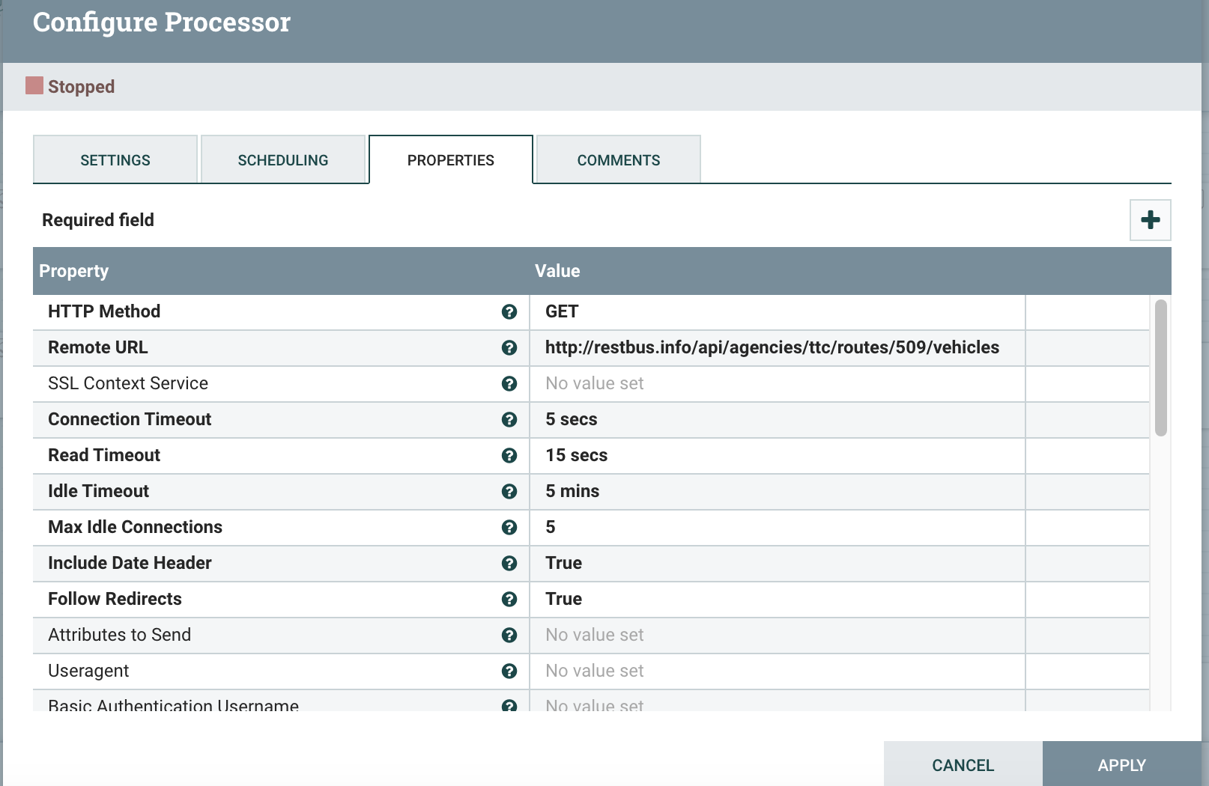
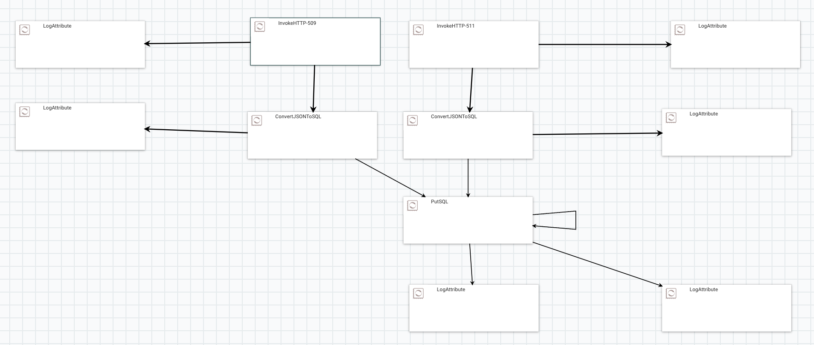
Apache Nifi

Slide 10
Stage 3: MySQL/CDC (Debezium)
We are here

Slide 11
MySQL/CDC (Debezium)
About
Tasks
Tip:
debezium/example-mysql:1.6 was used
Debezium is a distributed platform that turns your existing databases into event streams, so applications can quickly react to each row-level change in the databases.
Debezium is built on top of Kafka and provides Kafka Connect compatible connectors that monitor specific database management systems. Debezium records the history of data changes in Kafka topics.
The following tasks were completed:
Using EC2 instance; set up MySQL by Debezium docker container
Create a new database with a new table. The data from Bus API will be stored in the MySQL table using Nifi
Create the table with pre-defined schema. We are going to use it to collect data from the bus API.

Slide 12
Stage 4: Kafka
We are here

Slide 13
1/2
Kafka
About
Tasks
Tip:
debezium/kafka:1.6 docker image was used
debezium/connect:1.6 docker image was used
Running Debezium involves Zookeeper, Kafka, and services that run Debezium's connectors.
Debezium is built on top of Kafka and provides Kafka Connect compatible connectors that monitor specific database management systems. Debezium records the history of data changes in Kafka topics.
The following tasks were completed:
Using EC2 instance; set up and create Zookeeper, Kafka, and Debezium docker container
Link the "kafka" container and another container named "zookeeper." It allows the "kafka" container to communicate with the "zookeeper" container using the hostname "zookeeper."
Use Debezium connect container which will create a connection with Kafka, Zookeeper and MySQL containers.

Slide 14
2/2
Kafka
Tasks
Tip:
After stating mysql, nifi, zookeeper containers wait 3 seconds before starting kafka and connect containers
HTTP POST request to a Kafka Connect REST API running on localhost:8083
Make sure you don't have a duplicate connector name otherwise the data won't be consumed
At this stage there should be 5 containers running (in the order shown):
debezium/example-mysql:1.6
apache/nifi:1.12.0
debezium/zookeeper:1.6
debezium/kafka:1.6
debezium/connect:1.6
Enable MySQL debezium connector for Kafka Connect, so we can start monitoring changes in our MySQL target table using a curl command that creates a Kafka Connect connector named "inventory-connector_new" with specific configurations for connecting to a MySQL database and streaming data changes to a Kafka topic
Check if the Kafka topic was created and receiving data by exec into kafka docker container

Slide 15
Stage 5: Spark Streaming
We are here

Slide 16
Spark Streaming
About
Tasks
Tip:
Spark-3.3.3-bin-hadoop3 is to be installed
Spark Structured Streaming is a distributed platform that turns your existing databases into event streams, so applications can quickly react to each row-level change in the databases.
The following tasks were completed:
Using EC2 instance; install spark dependencies and packages on EC2
For pyspark to talk to kafka we need to install few packages in bin of spark-3.3.3-bin-hadoop3
Transform messages from Kafka into desired format using spark streaming and the schema provided

Slide 17
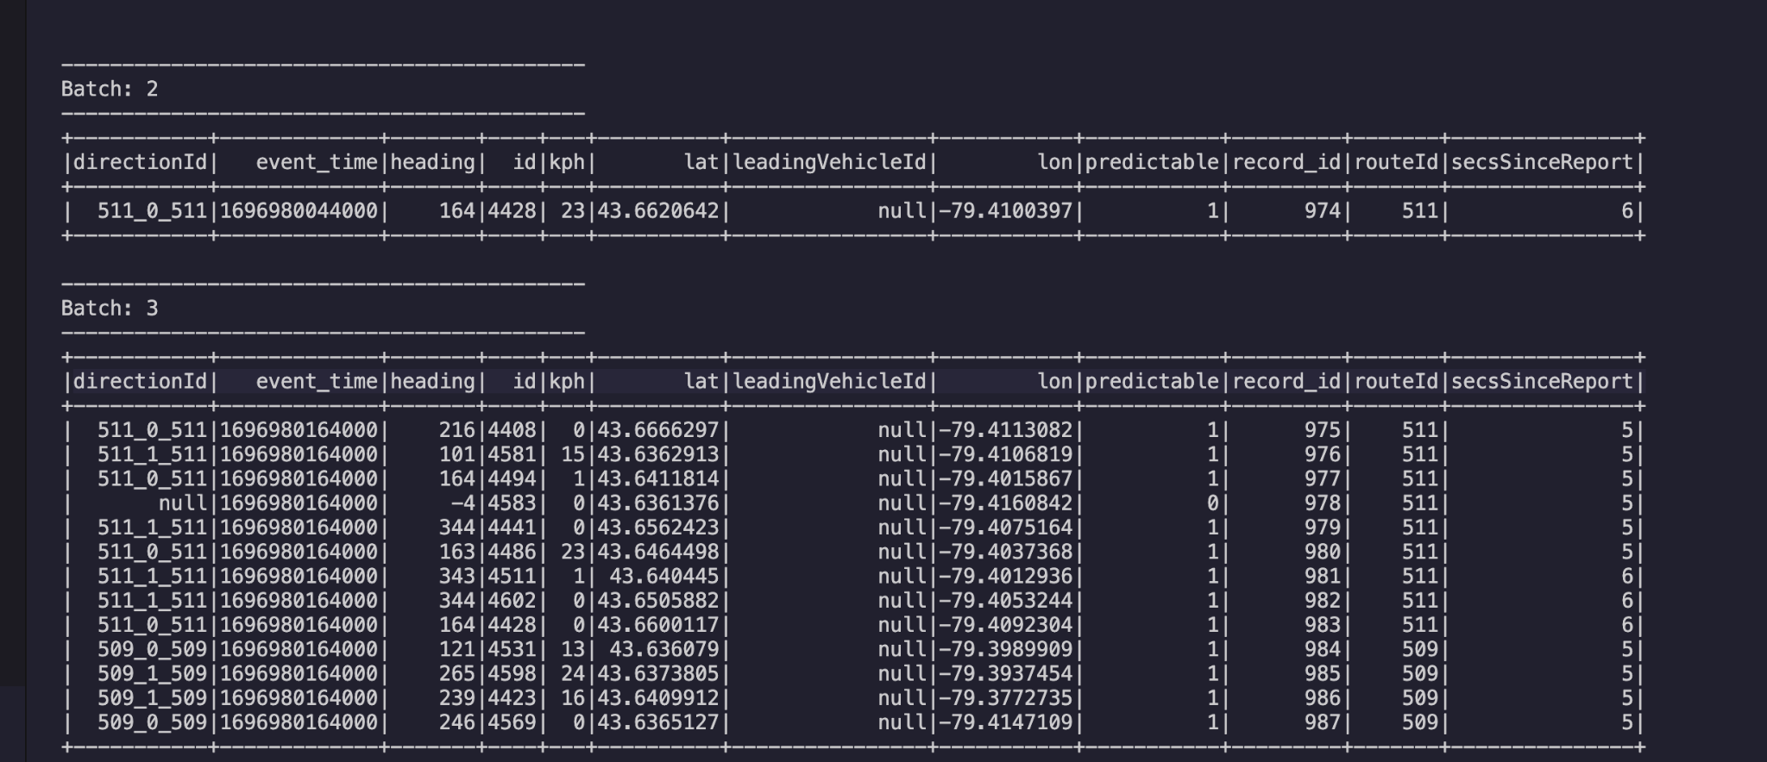
Spark Streaming
Sample Output
Here is a view of Kafka message consumed using Spark Streaming

Slide 18
Stage 6: Hudi/S3 Bucket
We are here

Slide 19
1/2
Hudi/S3 Bucket
About
Tasks
Tip:
Version 0.12.3 of Hudi is to be used
org.apache.hudi:hudi-spark3-bundle_2.12:0.12.3: This library is for using Apache Hudi with Spark
Apache Hudi is used with Amazon S3 to enable advanced data management features like efficient upserts, deletes, and incremental processing for data stored in S3 buckets, enhancing data lake capabilities. This combination allows for optimized query performance, real-time data processing, and improved data consistency and accessibility in large-scale data environments.
The following tasks were completed:
Give appropriate access to access S3 Bucket from different AWS services
Submit a PySpark application for execution. The application is designed to work with Apache Kafka and Apache Hudi, with optimized serialization for performance. The application runs in client mode, meaning the Spark driver will run on the machine where the command is executed.
Notes:
Apache Hudi is used with Amazon S3 to enable advanced data management features like efficient upserts, deletes, and incremental processing for data stored in S3 buckets, enhancing data lake capabilities. This combination allows for optimized query performance, real-time data processing, and improved data consistency and accessibility in large-scale data environments.
Apache Hudi is used in conjunction with Amazon S3 to efficiently manage large-scale data stored in S3 buckets. Hudi brings capabilities like upserts, incremental processing, and time travel to data stored in S3, enhancing the ability to handle complex data workloads.

Slide 20
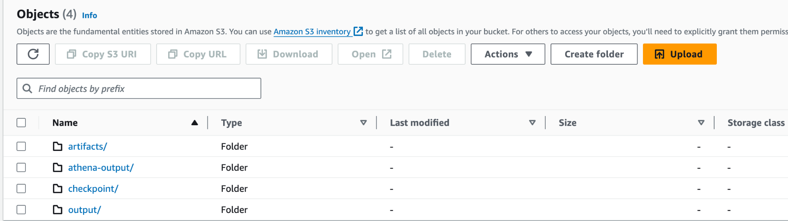
2/2
Hudi/S3 Bucket
Tasks
Tip:
COW is used in Hudi
"Append" mode is used in Hudi
The following objects were created in S3 bucket:
artifacts: to store schema json
output: to store output data
athena-output: output stored to be queried in athena
checkpoint: to store data incase of an emergency and restoring purposes

Slide 21
Stage 7: Athena/Data Studio
We are here

Slide 22
1/2
Athena/Data Studio
About
Tasks
Tip:
In Athena, partition by Route ID
Make sure the data types are correct in Athena table
Amazon Athena is an interactive query service provided by Amazon Web Services (AWS) that makes it easy to analyze data in Amazon S3 using standard SQL. Using athena tables created, Data Studio is used to produce visualizations for quick insights.
The following tasks were completed:
Create a table using Athena from S3 bucket
Deploy AWS Athena custom connector in Data Studio using App Script Code and Instructions (https://github.com/canyousayyes/datastudio-aws-athena-connector/tree/master/src, https://www.youtube.com/watch?v=vXCD9yAeryU)
Use Data Studio to display visualizations
Notes:
Apache Hudi is used with Amazon S3 to enable advanced data management features like efficient upserts, deletes, and incremental processing for data stored in S3 buckets, enhancing data lake capabilities. This combination allows for optimized query performance, real-time data processing, and improved data consistency and accessibility in large-scale data environments.
Apache Hudi is used in conjunction with Amazon S3 to efficiently manage large-scale data stored in S3 buckets. Hudi brings capabilities like upserts, incremental processing, and time travel to data stored in S3, enhancing the ability to handle complex data workloads.

Slide 23
Athena/Data Studio
Problems & Solutions: Athena
Problems & Solutions: Data Studio
Athena was not able to read tables from Hudi in S3.
The following tasks were done to fix the problems encountered:
Create table in athena using a sql script (make sure the data types are correct as per schema)
Add partition in the table in athena for each route (509 & 511)
There wasn't a connector to visualize the athena table in google data studio so a work around script was used to make a custom connector
The following tasks were done to fix the problems encountered:
Use google app script to initiate the connector setup
Create IAM user in AWS with programmatic access attach these policies; AmazonAthenaFullAccess & AmazonS3ReadOnlyAccess
In the connector, put in the credentials for athena and the table/database names for data connection
Data Studio will be able to automatically crawl the table upon successful connection

